Slide 1
Introduction to ReactJS
Taken from: https://reactjs.org/tutorial/tutorial.html

Slide 2
ReactJS setup
Follow instructions for local installation at:
https://reactjs.org/tutorial/tutorial.html
Create React App locally:
npm install -g create-react-app
npx create-react-app my-app
Follow instructions for creating a TicTacToe game frame

Slide 3
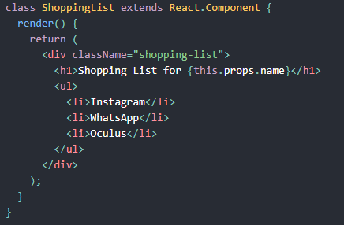
What is React?
React is a declarative, efficient, and flexible JavaScript library for building user interfaces.
It lets you compose complex UIs from small and isolated pieces of code called “components”.

Slide 4
React Component Class
Component tell React what we want to see on the screen
A component takes in parameters called props
Render method returns a description of what you want to see on the screen
Render returns a React element that describes what to render
React developers use JSX for writing structures to be rendered
JSX is an XML/HTML-like syntax that allows us to put HTML into JavaScript
React components can be composed and rendered as required
We can refer to above shopping list as <ShoppingList />
Each React component is encapsulated and can operate independently
This allows building complex UI4s from simple components

Slide 5
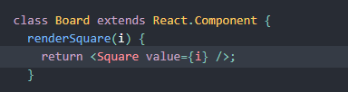
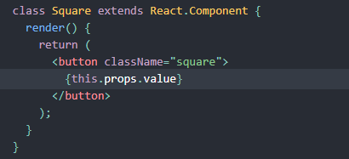
Passing Data Through Props
Change the renderSquare method to pass a prop called value to the Square:
Change Square’s render method to show the square value:

Slide 6
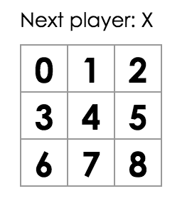
Result of passing a prop
Refresh the browser to see the number in each square
We passed a prop from a parent Board component to a Child square component
Information flows in React apps by passing props from parents to children

Slide 7
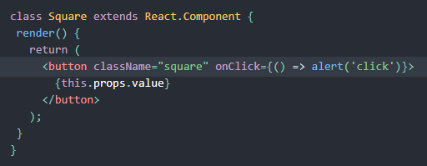
Making an interactive Component
Getting an alert
Note the use of arrow function

Slide 8
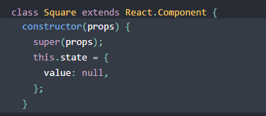
Using state to remember actions
State of a component is to be initialized in a constructor of a component
State should be considered as private to a React component
Add a constructor to the Square class to initialize state
Following JavaScript guidelines, all React component classes with a constructor should have a super(props) call

Slide 9
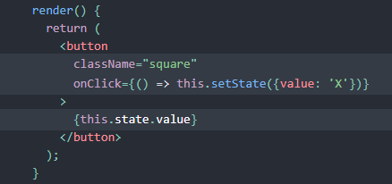
Changing the states
Use this.setState from an onClickhandler in the render method for changing state of a square
Calling a setState in a component will automatically update the child components inside it

Slide 10
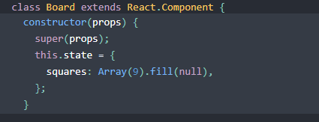
Lifting State Up
To determine winner, the value of each of the 9 squares need to be in one location
Best approach is to store game’s state in the parent Board component
Board tells each square what to display by passing a prop
Ass a constructor to Board and set initial values with 9 nulls

Slide 11
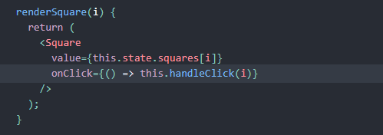
Passing States down to the Squares
Modify renderSquare method to read value from the board’s state
Pass down a function which will get called when a Square is clicked

Slide 12
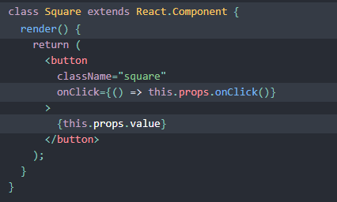
Modify Square Class
Board class passes down two props to Square: value and onClick
Square doesn’t need to keep track of state now, so we can delete square state
Also, delete square constructor and change render to the following:

Slide 13
What will happen when a Square is clicked?

Slide 14
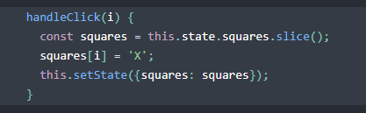
What will happen when a Square is clicked?
We have not defined the handleClick() method yet, so our code crashes
Add handleClick to the Board class
The Square component receive values from Board component
Square components are now controlled components

Slide 15
Mutability vs. Immutability
We used the .slice() operator to create a copy of the squares array instead of modifying the existing array
Mutation refers to changing data directly, other approach is replacing the data with a new copy
Immutability allows us to implement ‘time travel’ – useful for undo and redo operations
Detecting changes in the immutable objects is easier

Slide 16
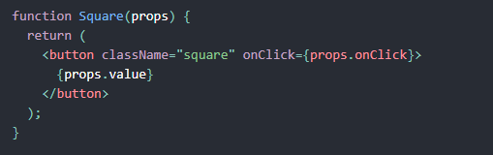
Function Components
React classes which contain only render method and don’t have own state could be converted to function components
Function takes props as input and returns what should be rendered
Replace the Square class with a function

Slide 17
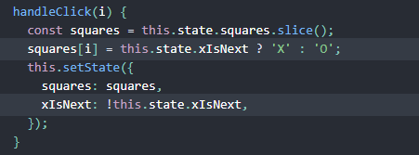
Adding Logic to Take Turns
First move is always X
Add xIsNext: true, to the Board state in it’s constructor
Change handleClick function to change the value of squares and xIsNext depending on the turn
Change status text in Board’s render to display player with next turn
const status = 'Next player: ' + (this.state.xIsNext ? 'X' : 'O’);

Slide 18
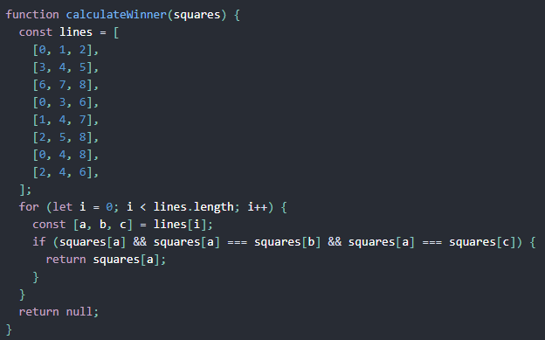
Calculating a Winner – Helper Function

Slide 19
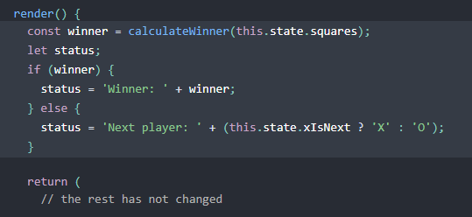
Announcing a Winner
Call calculateWinner(squares) in the Board’s render function
If a player has won, display text such as “Winner: X” or “Winner: O”

Slide 20
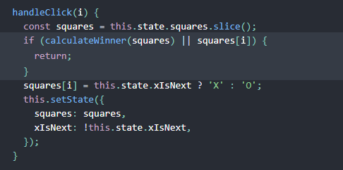
Ignore Clicks if Game is Finished
Change the Board’s handleClick function to return early by ignoring a click if someone has won the game or if a Square is already filled

Slide 21
Adding Time Travel
Homework

